Slide 1
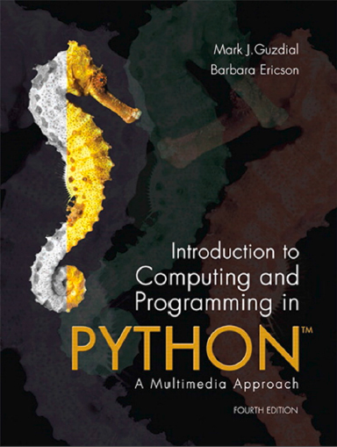
Introduction to Computing and Programming in Python™: A Multimedia Approach
Fourth Edition
Chapter 3
Creating and Modifying Text
Copyright © 2016, 2013, 2010 Pearson Education, Inc. All Rights Reserved
Notes:
If this PowerPoint presentation contains mathematical equations, you may need to check that your computer has the following installed:
1) MathType Plugin
2) Math Player (free versions available)
3) NVDA Reader (free versions available)

Slide 2
Learning Objectives
3.1 To create human-usable text (like stories) via programs.
3.2 To generate text patterns, including "double dutch" language.
3.3 To manipulate strings.
3.4 To build strings with concatenation.
3.5 To use loops to iterate over characters in a string.
3.6 To convert strings into lists for manipulation.
3.7 To use array notation for accessing elements of strings and lists.

Slide 3

Which of the Statements Below is True after These Two Statements are Executed? (Can Be More Than One.)
Variable a Is Now Empty
Variable a Is Still 10
Variable b Is Now 10
If We Change Variable a Again, b Will Change
Notes:
2 and 3

Slide 4
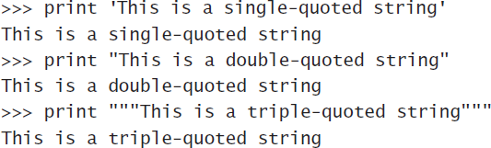

Strings
Strings are defined with quote marks.
Python actually supports three kinds of quotes:
Use the right one that allows you to embed quote marks you want

Slide 5

What Type of Data is in the Variable Filename After Executing This Statement?
File name
Picture
String
Float
Notes:
#3

Slide 6
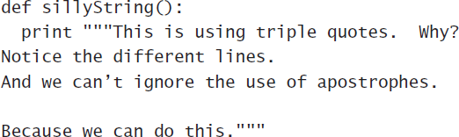
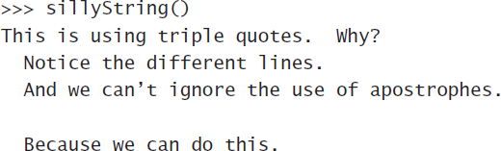
Triple Quotes Allow Us to Embed

Slide 7
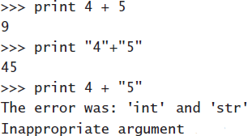
Adding Strings and Numbers: Not Together
Adding strings together is called “concatenation”

Slide 8
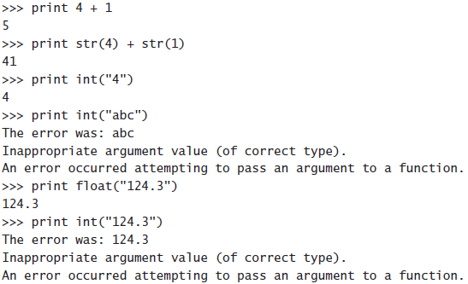
Unless You Convert
Using int() and float(), you can convert strings to numbers.
If the string is a valid integer or floating-point number.
Using str(), you can convert numbers to strings.

Slide 9

This Will Result in:
13
An Error
“12”
“121”
Notes:
#4

Slide 10
How Could This Be? (1 of 2)
An Error Because String Can’t Be Redefined.
String Is “1.0000000000/3”
String Is “0.333333333333”
String Is “1/3.0000000000”
Notes:
#3

Slide 11
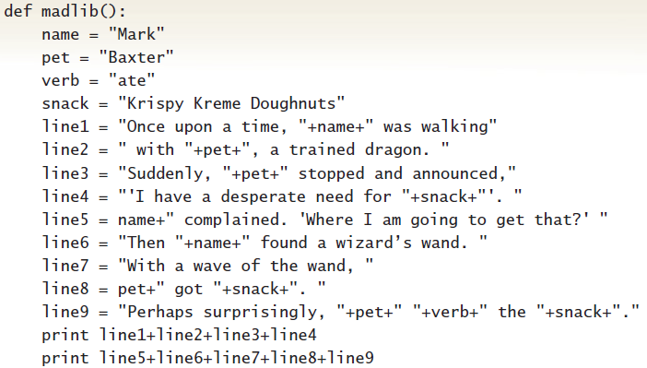
Using String Concatenation to Tell a Madlib Story

Slide 12
Running Our Madlib Function
Once upon a time, Mark was walking with Baxter, a trained dragon. Suddenly, Baxter stopped and announced,' I have a desperate need for Krispy Kreme Doughnuts'.
Mark complained. 'Where I am going to get that?' Then Mark found a wizard's wand. With a wave of the wand, Baxter got Krispy Kreme Doughnuts. Perhaps surprisingly, Baxter ate the Krispy Kreme Doughnuts.

Slide 13
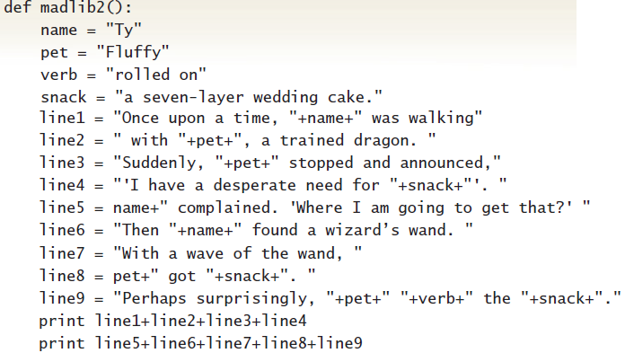
Telling a Different Madlib Story
Notes:
Generating

Slide 14
Running New One
Once upon a time, Ty was walking with Fluffy, a trained dragon. Suddenly, Fluffy stopped and announced,' I have a desperate need for a seven-layer wedding cake.'.
Ty complained. 'Where I am going to get that?' Then Ty found a wizard's wand. With a wave of the wand, Fluffy got a seven-layer wedding cake.. Perhaps surprisingly, Fluffy rolled on the a seven-layer wedding cake.

Slide 15
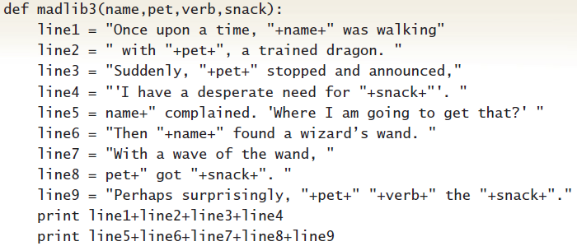
Generalizing Madlib with Parameters

Slide 16
Can Generate New Madlib Stories without Changing Program
("Lee","Spot","stomped on","Taco Bell
nachos")
Once upon a time, Lee was walking with Spot, a trained dragon. Suddenly, Spot stopped and announced,' I have a desperate need for Taco Bell nachos'.
Lee complained. 'Where I am going to get that?' Then Lee found a wizard's wand. With a wave of the wand, Spot got Taco Bell nachos. Perhaps surprisingly, Spot stomped on the Taco Bell nachos.

Slide 17
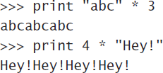
Multiplication is Repeated Addition: Strings, Too
Multiplication concatenates copies of the string

Slide 18
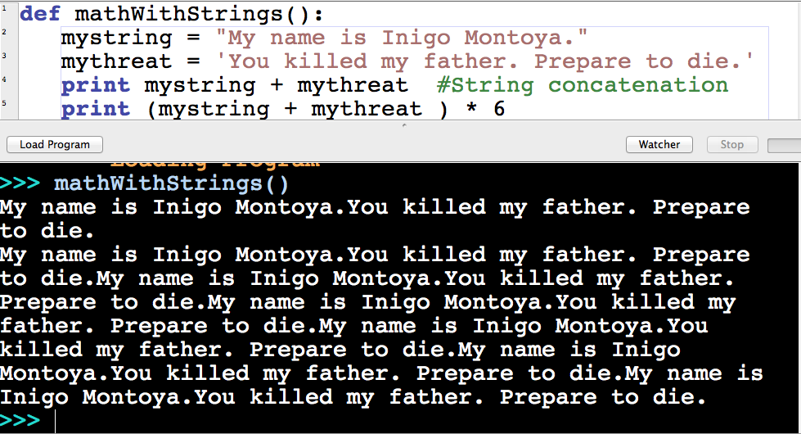
Princess Bride in Python

Slide 19
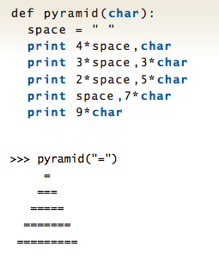
A Pyramid in Python

Slide 20
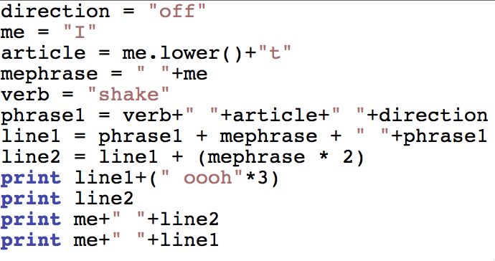
What Does This Print?
Notes:
Four lines of Taylor Swift’s “Shake it off”

Slide 21

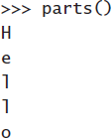
Taking Strings Apart
Read for as “for each”
“For each letter in the string…print the letter.”

Slide 22
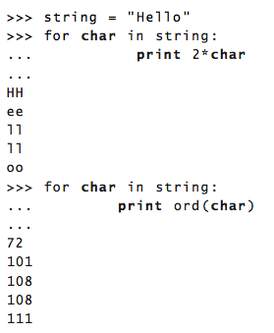
The for Loop
The word for has to be there.
Next comes the index variable that will take on the value of each element of the collection.
The word in has to be there
The colon (“:”) says, “Next comes the body of the loop.”
The statements in the body of the loop must be indented.
Anything can be inside the for loop

Slide 23
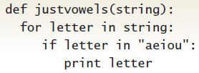
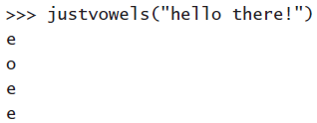
Using if to Test the Letters (1 of 2)

Slide 24

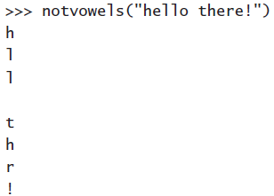
Using if to Test the Letters (2 of 2)

Slide 25
Two Different Ways to Deal with Case

Slide 26
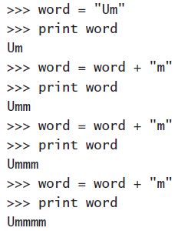
Collecting Characters into Strings

Slide 27
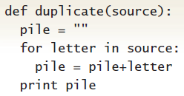

Return a New String from Pieces

Slide 28
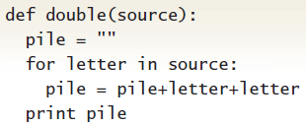

More Interesting: Double

Slide 29
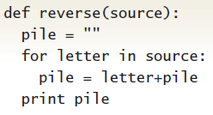

More Interesting: Reverse

Slide 30
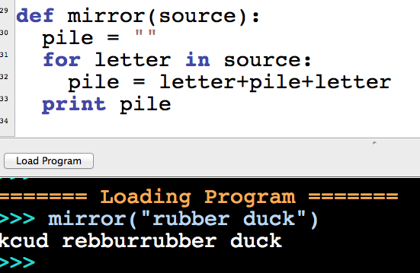
Mirroring
We can add the index variable to both sides of the pile

Slide 31

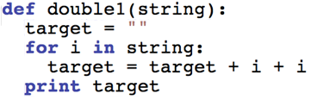

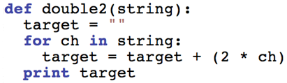

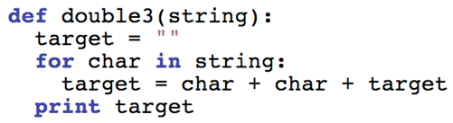

Two of These “Double” Programs Produces This
>>> double_(“apple") aappppllee which one doesn’t?
Notes:
#2

Slide 32
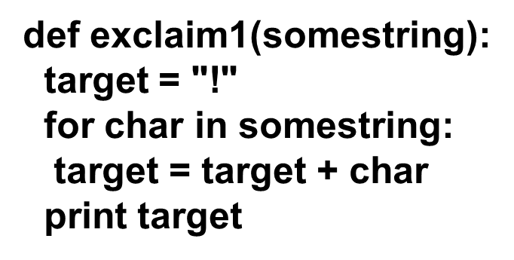
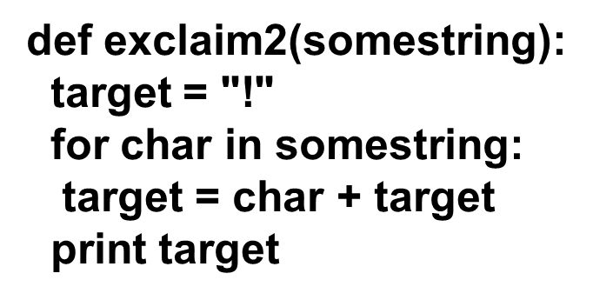
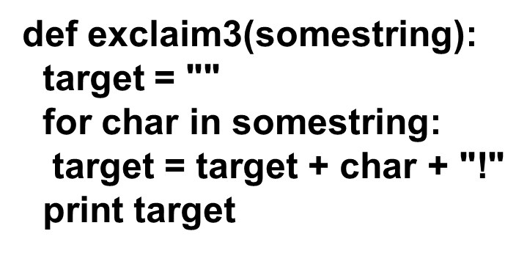
Only One of These Programs Prints More Than One Exclamation Point
Which One is it?
Notes:
#2

Slide 33
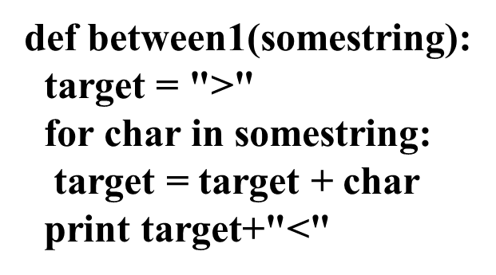
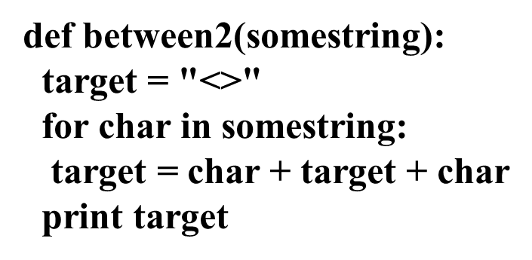
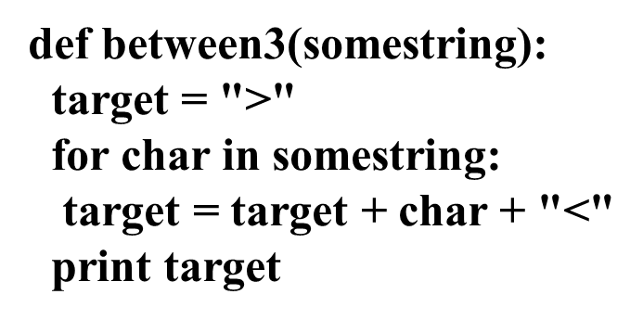
One of These, When You Call it with the Input of “between” Will Print: >B < e < t < w < e < e < n< Which One?
Notes:
#2

Slide 34
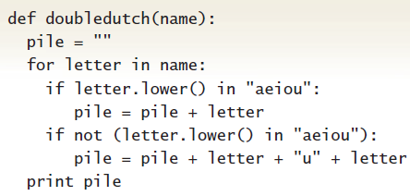
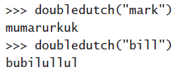
Creating Language Patterns

Slide 35
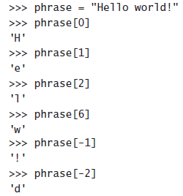
Using Square Bracket Notation
The first character is at index 0.
Negative index values reference the end of the list

Slide 36
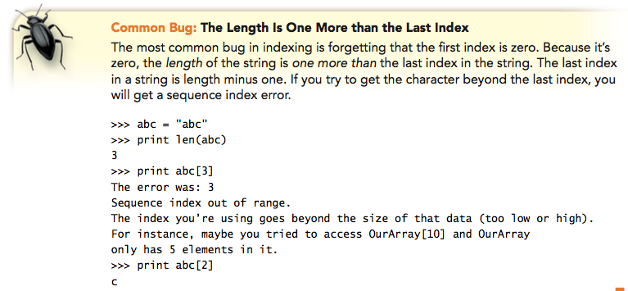
The Function len( ) Gives You the Number of Elements
Not the last index position.

Slide 37
How Could This Be? (2 of 2)
An error because string can’t be redefined.
string is “1.0000000000/3”
string is “0.333333333333”
string is “1/3.0000000000”
Notes:
#3

Slide 38
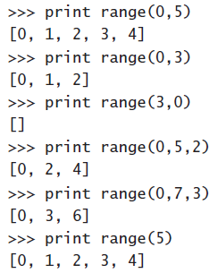
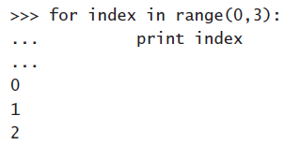
Use the Range( ) Function to Generate Index Values

Slide 39

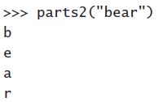
Print the String, by Index

Slide 40
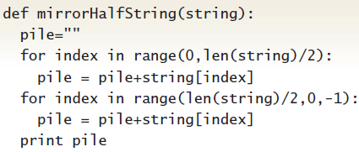
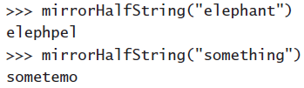
Mirroring, by Index

Slide 41
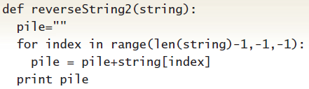

Reversing, by Index

Slide 42
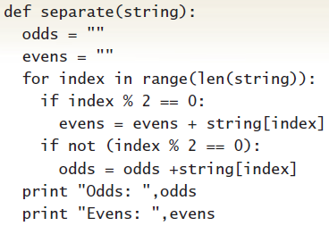

Separating, by Index

Slide 43
If I Want to Print the “e” Which Should I Use?
Print Word[4]
Print Word[3]
Print Word[5]
Print Word[E]
Notes:
2 and 3

Slide 44
If I Want to Print the “g” Which Should I Use?
print word[-1]
print word[‘g’]
print word[9]
print word[8]
Notes:
2 and 3

Slide 45
If I Want to Print “Thing” Which Should I Use?
print word[4:9]
print word[5:9]
print word[4:10]
print word[4:8]
Notes:
2 and 3

Slide 46
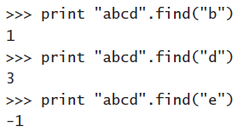
Getting an Index for a String

Slide 47
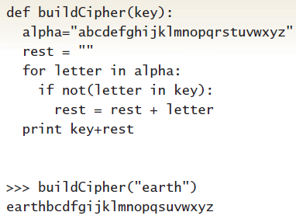
Creating a Cipher Alphabet

Slide 48
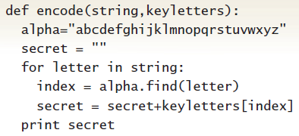
Encoding with Keyword Cipher

Slide 49
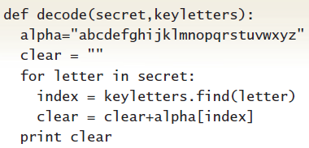
Decoding with Keyword Cipher
Why z? Think about spaces

Slide 50
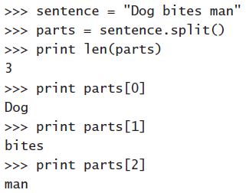
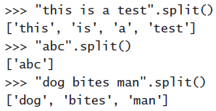
Splitting Strings into Words

Slide 51
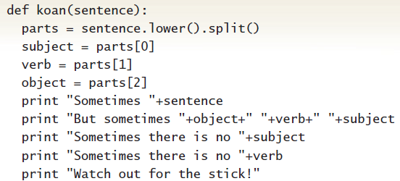
Koan Generator

Slide 52

Making a Koan

Slide 53

Doesn’t Know About Articles

Slide 54

Is This Word Here?

Slide 55

Koan Generator with Articles

Slide 56

Better!

Slide 57
Encodings for Strings
Strings are just arrays of characters
In most cases, characters are just single bytes.
The A S C I I encoding standard maps between single byte values and the corresponding characters
More recently, characters are two bytes.
Unicode uses two bytes per characters so that there are encodings for glyphs (characters) of other languages
Java uses Unicode. The version of Python we are using is based in Java, so our strings are actually using Unicode.

Slide 58
Special Invisible Characters
Backslash escapes
\t is the tab character
\b is backspace
\n is newline
\r is return
\uX X X X is a Unicode character where X X X X is a hexadecimal number (digits 0-9 plus characters A - F).

Slide 59

What does this Function Print?
(1) “newstring”
(2) It will print whatever was input (in astring)
(3) It will print whatever was input backwards
(4) It will generate an error
Notes:
#2

Slide 60
There are Only Six Things Computers Can Do
They can store data with a name(s).
They can name parts of programs (instructions), and follow those instruction when commanded.
They can take data apart.
They can transform data into other forms.
They can follow a set of instructions repeatedly.
They can test data (is this true or not?), then take actions depending on what the result is.
That’s it!
Knowing how to tell the computer to do these six things is all there is to programming a computer.
You have now seen them all

Slide 61

Copyright

